Slide 1
I2P mid practice - Simple Addition
Four integer arrays a, b, c and d with size m x n.
Choose one array from b, c and d.
Choose b.
Select elements
(0,0)
(m-1,n-1)
Calculate the sum:
a(0,0)+a(m-1,n-1)+b(0,0)+b(m-1,n-1)
b
(0,0) | … | (0,n-1)
(m-1,0) | … | (m-1,n-1)
a
c
d
(0,0) | … | (0,n-1)
(m-1,0) | … | (m-1,n-1)
(0,0) | … | (0,n-1)
(m-1,0) | … | (m-1,n-1)
(0,0) | … | (0,n-1)
(m-1,0) | … | (m-1,n-1)
…

Slide 2
Take sample input as an example.
Sample input
3 2
0 1 2 3 4 5
0 1 4 9 16 25
0 1 2 0 1 2
0 2 8 7 10 6
2
2
1 0
2 0
a
b
3 x 2 arrays
0 | 1
2 | 3
4 | 5
0 | 1
4 | 9
16 | 25
array a
array b
array c
c
d
array d
0 | 1
2 | 0
1 | 2
0 | 2
8 | 7
10 | 6

Slide 3
Take sample input as an example.
Sample input
3 2
0 1 2 3 4 5
0 1 4 9 16 25
0 1 2 0 1 2
0 2 8 7 10 6
2
2
1 0
2 0
Sample input
3 2
0 1 2 3 4 5
0 1 4 9 16 25
0 1 2 0 1 2
0 2 8 7 10 6
2
2
1 0
2 0
a
(array ID: 0)
b
0 | 1
2 | 3
4 | 5
0 | 1
4 | 9
16 | 25
(array ID: 1)
(array ID: 2)
c
d
0 | 1
2 | 0
1 | 2
0 | 2
8 | 7
10 | 6
choose array d
select 2 elements
select (1, 0)
select (2, 0)

Slide 4
Take sample input as an example.
Sample Output
24
a
b
← 2+4+8+10
0 | 1
2 | 3
4 | 5
0 | 1
4 | 9
16 | 25
c
d
0 | 1
2 | 0
1 | 2
0 | 2
8 | 7
10 | 6

Slide 5

Prerequisite of the task
In main.c
entry[0]
a
b
index_to_add
0 | 1
2 | 3
4 | 5
0 | 1
4 | 9
16 | 25
1
0
2
0
(1,0)
(2,0)
entry[1]
entry[2]
c
d
0 | 1
2 | 0
1 | 2
0 | 2
8 | 7
10 | 6

Slide 6
Task: implement a given addition function as follows
In main.c
Number of elements been selected
Function prototype
int num_element
int addition( )
int* ptr_a,
int array_ID,
int* entry[],
int *index,
ptr_a
entry[0]
entry[1]
entry[2]
a
b
c
(array ID: 0)
d
(array ID: 1)
(array ID: 2)
0 | 1
2 | 3
4 | 5
0 | 1
4 | 9
16 | 25
0 | 1
2 | 0
1 | 2
0 | 2
8 | 7
10 | 6
index
Remember that
index_to_add
1
0
2
0

Slide 7
（再回顧）
int sum(int * ap, int n)
{
int i, total = 0;
for (i = 0; i < n; i++)
total += ap[i]; /* total = total + *(ap + i); */
return total;
}
You can also write
int sum(int a[], int n)
{
…
}
The same function declarations:
int sum(int * ap, int n);
int sum(int a[], int n);
int sum(int *, int);
int sum(int [], int);
把陣列的size單獨丟過去
背起來!!!陣列的傳輸方式也就這兩個!!!
一維陣列:
星星a 等於 a空的框框。
二維三維多維也只不過是一維的延伸而已。
其實，下半部的宣告方式完全就是上半部而已。
更詳細來講，
第1種宣告方式完全等於第3種，
而第2種完全等於第4種。
上半和下半差別只在於有沒有給每個參數名稱而已。

Slide 8
Task: implement a given addition function as follows
index
index_to_add
1
0
2
0
In function.c
int num_element
int addition( )
{
int i, sum = 0;
int position;
/*Add all the designated elements*/
for(i = 0 ; i < num_element ; i++)
{
/*Calculate the position of the element */
position = index[2*i]*50+index[2*i+1];
sum = sum + *(ptr_a+position) + *(entry[array_ID]+position);
}
return sum;
}
int* ptr_a,
int array_ID,
int* entry[],
int *index,
都是傳入一維陣列
a
50
背起來!!!陣列的傳輸方式也就這兩個!!!
一維陣列:
星星a 等於 a空的框框。
二維三維多維也只不過是一維的延伸而已。
ptr_a
0 | 1
2 | 3
4 | 5
50
50
d
entry[2]
0 | 2
8 | 7
10 | 6
這句其實是在算: 位置偏移量
50

Slide 9
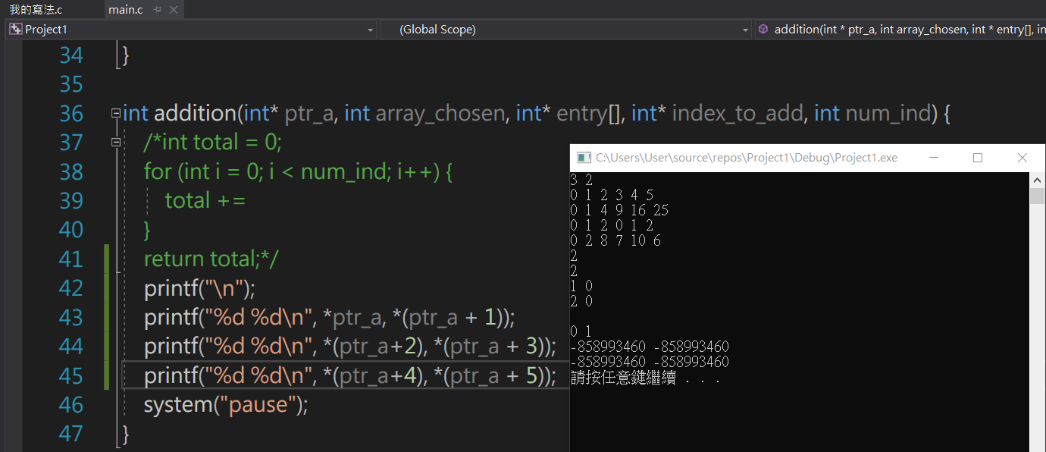
看完學長寫的code，
你知道之前所寫的code的錯誤在哪裡了嗎?

